Slide 1
Oracle Applications Development Tools Setup

Slide 2
What to Expect from the session
After the session there will be clear understanding of below mentioned topics
Setup Development Tools on Desktop:
SQL Developer
PL/SQL Developer
Forms Builder
Report Builder
Putty
FTP
Access to Oracle MySupport Portal

Slide 3
Topics
SQL Developer
Oracle Form Builder
Oracle Report Builder
Putty
FTP
Oracle MySupport Portal(MetaLink)
End

Slide 4
SQL Developer
Go to http://www.oracle.com/technetwork/developer-tools/sql-developer/overview/index.html
(Use chrome browser)
Click on download button as shown below
After downloading the setup file, install the software on your system

Slide 5
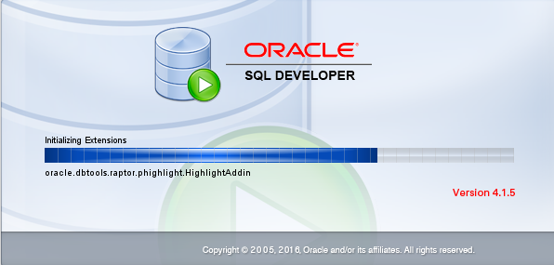
SQL Developer
Open SQL Developer

Slide 6
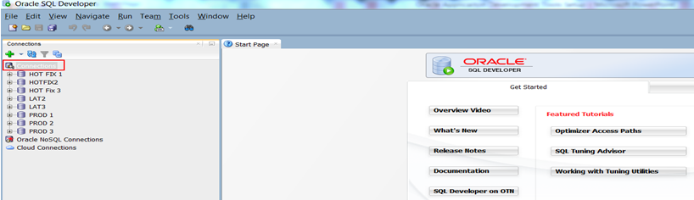
SQL Developer
Import Database Connection File(XML File)
Right click on the connection (Red Square Box)
Import Connections ->Select Connection XML File

Slide 7
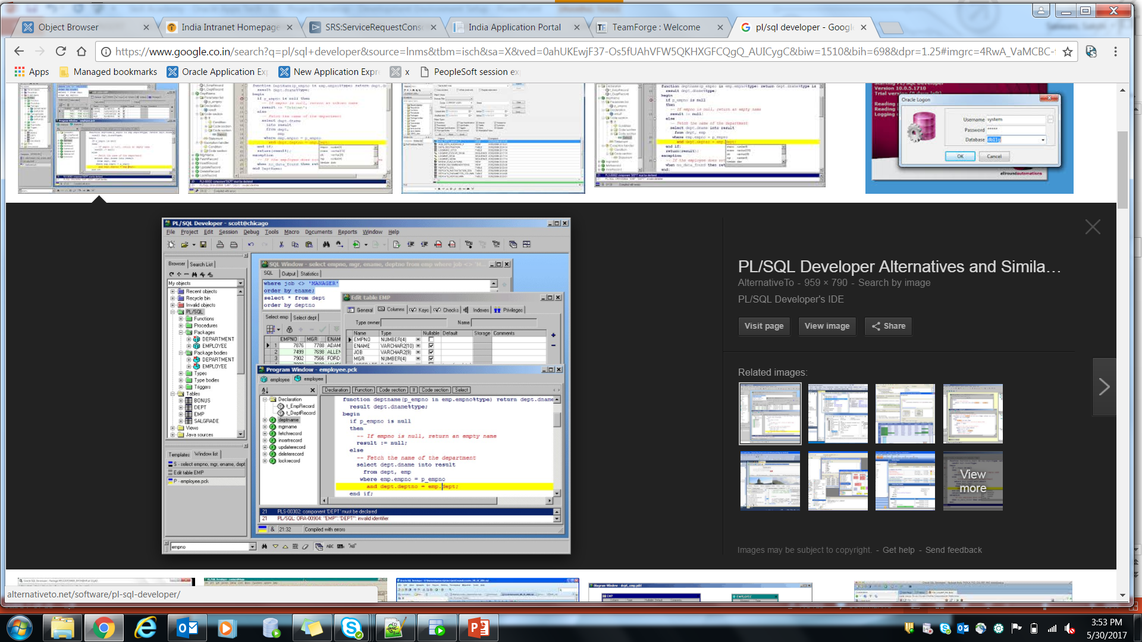
PL/SQL Developer
This is same as SQL Developer.
PL/SQL Developer is an
Integrated Development
Environment that is
specifically targeted at the
development of stored
program units for
Oracle Databases

Slide 8
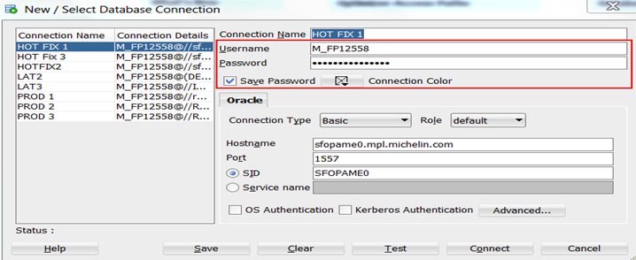
Entering Username and Password
Right click on any connection -> Properties
Enter username and password.Don’t change anything else.Then save and connect.

Slide 9

Oracle Form Builder
Go to http://www.oracle.com/technetwork/developer-tools/forms/downloads/index.html
(Use chrome browser)
Click on download button as shown below
After downloading the setup file,install the software on your system

Slide 10
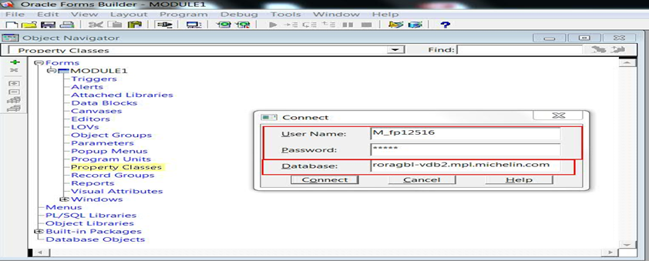
Oracle Form Builder
Open the form builder and connect to database

Slide 11
Oracle Report Builder
Go to http://www.oracle.com/technetwork/developer-tools/forms/downloads/index.html
(Use chrome browser)
Click on download button as shown below
After downloading the setup file,install the software on your system

Slide 12
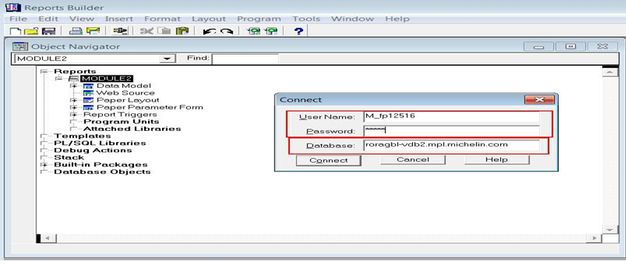
Oracle Report Builder
Open the report builder and connect to database

Slide 13

Putty
Go to http://appstore.in.capgemini.com/CMapplicationCatalog/#/SoftwareCatalog
(Use Internet Explorer Browser)
Click on image to download
After downloading the setup file, install the software on your system

Slide 14
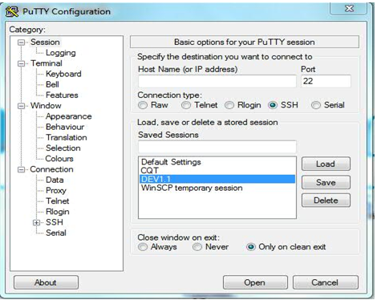
Putty
Open the putty and connect to the instance

Slide 15
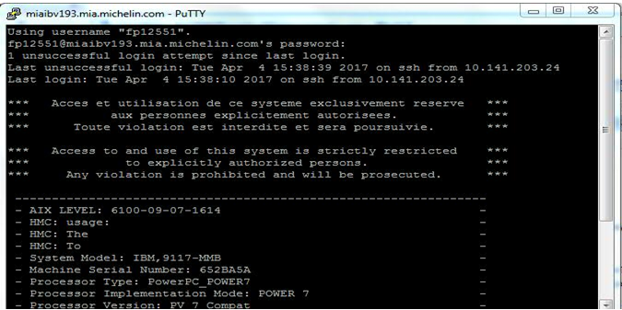
Putty
After entering the host details below screen will prompt for user name and password

Slide 16
WINSCP
Go to https://winscp.net/download/WinSCP-5.9.4-Setup.exe
(Use Chrome Browser)
The setup file will be downloaded automatically
After downloading the setup file,Install the software on the system.

Slide 17
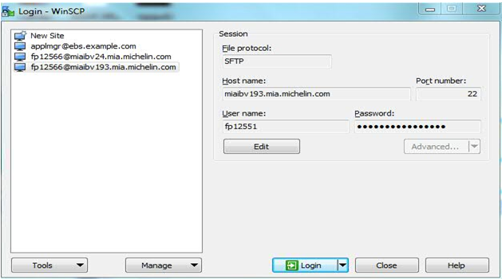
WINSCP
Open the WINSCP
Enter credentials to Connect

Slide 18
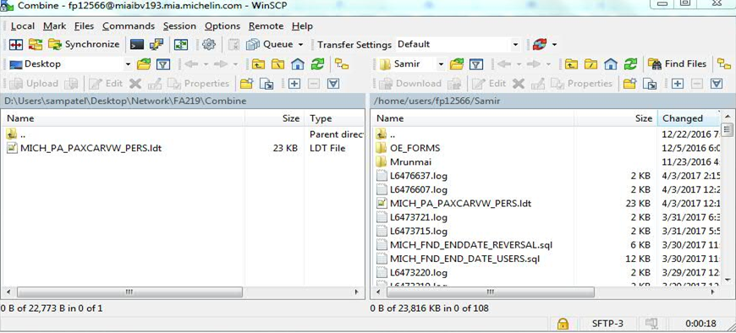
WINSCP
Below screen will appear after connection

Slide 19
Oracle MySupport Portal(MetaLink)
In order to download the Oracle Development Tools, you need to have Oracle account.
Go to https://login.oracle.com/mysso/signon.jsp
Sign in by entering user name and password.
If you don’t have Oracle account please create it.

Slide 20
Questions and Answers

